Slide 1
Building Windows Presentation Foundation (WPF) Application

Slide 2
Objectives
Overview Windows Presentation Foundation (WPF)
Overview XAML(eXtensible Application Markup Language) in WPF
Explain about Controls and Layouts in WPF
Explain about Styles and Templates in WPF
Explain about WPF Data-Binding Model
Demo create WPF application by dotnet CLI and Visual Studio.NET
Demo access to the database by WPF Application
Explain about MVVM Pattern (Model-View-ViewModel)

Slide 3
Overview Windows Presentation Foundation (WPF)

Slide 4
WPF History
WPF version 3.0 was first released as a part of .NET Framework 3.0 in the year 2006 and received its major updates and enhancements in version 3.5 which was released with .NET Framework 3.5.
An overall timeline about the feature and updates that were added in subsequent major releases and current is WPF version of .NET Framework 4.8 and .NET 5 (.NET Core)

Slide 5
What is Windows Presentation Foundation?
Windows Presentation Foundation (WPF) is a UI framework that creates desktop client applications
The WPF development platform supports a broad set of application development features, including an application model, resources, controls, graphics, layout, data binding, documents, and security
The framework is part of .NET, so if we have previously built applications with .NET using ASP.NET or Windows Forms, the programming experience should be familiar

Slide 6
What is Windows Presentation Foundation?
WPF uses the Extensible Application Markup Language (XAML) to provide a declarative model for application programming
WPF applications are based on a vector graphics architecture. This enables applications to look great on high DPI (Dots per inch) monitors, as they can be infinitely scaled
WPF also includes a flexible hosting model, which makes it straightforward to host a video in a button, for example
The visual designer provided in Visual Studio makes it easy to build WPF application, with drag-in-drop and/or direct editing of XAML markup

Slide 7
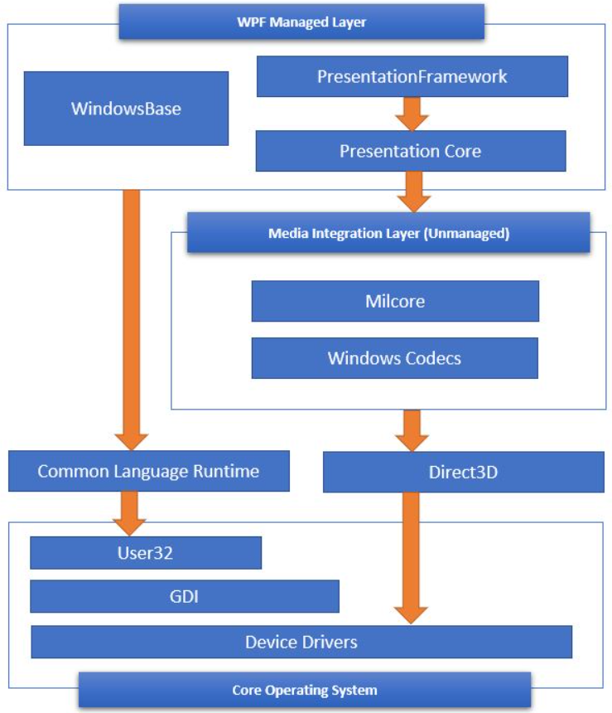
WPF Architecture
Managed Layer: The layer is composed of three different services:
PresentationFramework.dll: This DLL provides the basic types to build a WPF application, such as windows, controls, shapes, media, documents, animation, data bindings, style and many more
PresentationCore.dll: This DLL provides basic types like UIElement and Visual. The UIElement defines the actions and element layout properties and provides classes to override them if required

Slide 8
WPF Architecture
WindowBase.dll: This DLL holds the WPF basic types like DependencyProperty, DependencyObject, DispatcherObject, and other types. The important one is given below:
DependencyProperty: provides a new property system that can enable or disable function like data binding, define attach properties, etc
DependencyObject: is the base of every WPF types and provides the function to enable property notification
DispatcherObject: This class provides a way for thread safety and threads other than Dispatcher created cannot directly access it

Slide 9
WPF Architecture
Unmanaged Layer: This layer consist of two different services:
Milcore.dll: This is the media integration library or milcore that provides direct interaction with the DirectX and renders all the UI elements through this engine
WindowsCodecs.dll: This DLL provides the services for imaging like displaying, scaling, etc
Direct3D: This DLL provides access to low-level API which helps in rendering in WPF
User32: This is the basic core OS functionality that every application on Windows uses

Slide 10
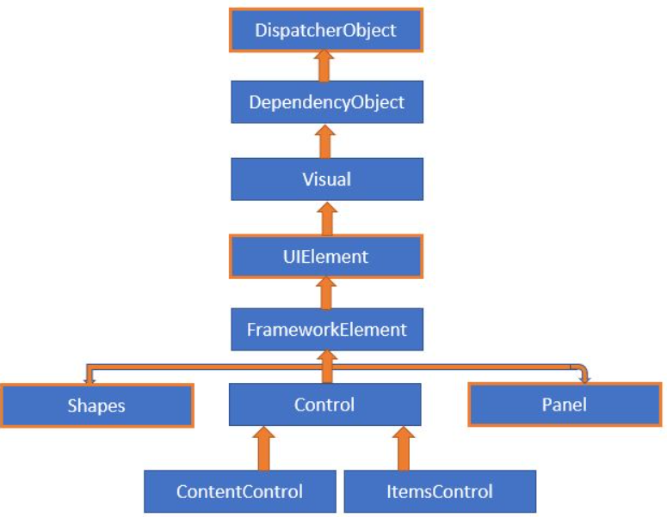
Basic Class Hierarchy of WPF Types
DispatcherObject: WPF application uses Single-Thread Affinity (STA) model and therefore every UI element is owned by a single thread
DependencyObject: WPF introduced a new property system called the Dependency Property having features like change notification, support data bindings, attached properties, etc
Visual: The Visual class defines all the properties required for rendering, clipping, transforming, bounding, and hit test. All the user interface controls like Button, ListBox derive from this class

Slide 11
Basic Class Hierarchy of WPF Types
UIElement: This class adds the basic functionality of layout, input, focus, and events to UI elements and sets the basic foundation of the layout process
FrameworkElement: This class extends the functionality provided by the UIElement, and override the layout for framework level implementations
Shapes: This class is the base class for shape elements like Line, Ellipse, Polygon, Path, etc
Controls: This namespace contains all the elements that help in interacting with the user. Few of the control like Textbox, Button, Listbox, Menu, etc are present in this namespace. Font, Background color, and control appearances support via templates support are added from this namespace

Slide 12
Basic Class Hierarchy of WPF Types
ContentControl: This is the base class for all the control that supports only single content. Control from Label, Button, Windows, etc. The appearance of the control can be enhanced using a data template
ItemsControl: This is the base class for all the control that displays a list of items and includes controls like, ListBox, TreeView, Menus, Toolbar, etc. ControlTemplate can be used to change the appearance of the control and ItemsTemplate can be applied to define how the objects will be displayed on the control
Panel: This class is the base class of all the layout container elements. The class can host child objects and provides service to position and arrange child objects in the user interface. Control like Grid, Canvas, DockPanel, StackPanel, WrapPanel, etc derives from this class

Slide 13
WPF Capabilities and Features
Providing a Separation of Concerns via XAML
One of the most compelling benefits is that WPF provides a way to cleanly separate the look and feel of a GUI application from the programming logic
Using XAML, it is possible to define the UI of an application via XML markup. This markup (ideally generated using tools such as Microsoft Visual Studio or Blend for Visual Studio) can then be connected to a related C# code file to provide the guts of the program’s functionality
XAML allows us to define not only simple UI elements (buttons, grids, list boxes, etc.) in markup but also interactive 2D and 3D graphics, animations, data-binding logic, and multimedia functionality (such as video playback)

Slide 14
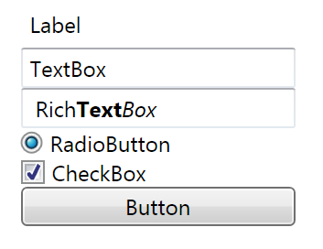
XAML sample
<Window ... >
...
<Label>Label</Label>
<TextBox>TextBox</TextBox>
<RichTextBox ... /> <RadioButton>RadioButton</RadioButton>
<CheckBox>CheckBox</CheckBox>
<Button>Button</Button>
</Window>

Slide 15
WPF Capabilities and Features
Providing an Optimized Rendering Model
The WPF programming model is quite different, in that GDI is not used when rendering graphical data. All rendering operations (e.g., 2D graphics, 3D graphics, animations, control rendering, etc.) now make use of the DirectX API
The first obvious benefit is that our WPF applications will automatically take advantage of hardware and software optimizations
As well, WPF applications can tap into very rich graphical services (blur effects,anti-aliasing, transparency, etc.) without the complexity of programming directly against the DirectX AP
If we want to build a desktop application that requires the fastest possible execution speed (such as a 3D video game), unmanaged C++ and DirectX are still the best approach

Slide 16
WPF Capabilities and Features
Simplifying Complex UI Programming
A number of layout managers (far more than Windows Forms) to provide extremely
flexible control over the placement and repositioning of content
Use of an enhanced data-binding engine to bind content to UI elements in a variety
of ways and a built-in style engine, which allows us to define “themes” for a WPF
application
Use of vector graphics, which allows content to be automatically resized to fit the size and resolution of the screen hosting the application
Support for 2D and 3D graphics, animations, and video and audio playback
A rich typography API, such as support for XML Paper Specification (XPS) documents, fixed documents (WYSIWYG), flow documents, and document annotations (e.g., a Sticky Notes API)
Support for interoperating with legacy GUI models (e.g., Windows Forms, ActiveX, and Win32 HWNDs)

Slide 17
The WPF Assemblies
The following table will describe the key assemblies used to build WPF applications, each of which must be referenced when creating a new project:
Assembly | Description
PresentationCore | This assembly defines numerous namespaces that constitute the foundation of the WPF GUI layer. For example, this assembly contains support for the WPF Ink API, animation primitives, and numerous graphical rendering types
PresentationFramework | This assembly contains a majority of the WPF controls, the Application and Window classes, support for interactive 2D graphics, and numerous types used in data binding
System.Xaml.dll | This assembly provides namespaces that allow us to program against a XAML document at runtime. By and large, this library is useful only if we are authoring WPF support tools or need absolute control over XAML at Runtime
WindowsBase.dll | This assembly defines types that constitute the infrastructure of the WPF API, including those representing WPF threading types, security types, various type converters, and support for dependency properties and routed Events

Slide 18
The WPF Namespaces
The following table describes the role of some of the important namespaces in WPF:
Assembly | Description
System.Windows | This is the root namespace of WPF. Here, we will find core classes (such as Application and Window) that are required by any WPF desktop project
System.Windows.Controls | This contains all of the expected WPF widgets, including types to build menu systems, tooltips, and numerous layout managers
System.Windows.Documents | This contains types to work with the documents API, which allows us to integrate PDF-style functionality into our WPF applications, via the XML Paper Specification (XPS) protocol
System.Windows.Ink | This provides support for the Ink API, which allows us to capture input from a stylus or mouse, respond to input gestures, and so forth. This is useful for Tablet PC programming; however, any WPF can make use of this API

Slide 19
The WPF Namespaces
Namespace | Description
System.Windows.Markup | This namespace defines a number of types that allow XAML markup (and the equivalent binary format, BAML) to be parsed and processed programmatically
System.Windows.Media | This is the root namespace to several media-centric namespaces. Within these namespaces we will find types to work with animations, 3D rendering, text rendering, and other multimedia primitives
System.Windows.Navigation | This namespace provides types to account for the navigation logic employed by XAML browser applications (XBAPs) as well as standard desktop applications that require a navigational page model
System.Windows.Shapes | This defines classes that allow us to render interactive 2D graphics that automatically respond to mouse input
System.Windows.Data | This contains types to work with the WPF data-binding engine, as well as support for data-binding templates

Slide 20
Demo 01: Create a WPF Application using dotnet CLI

Slide 21
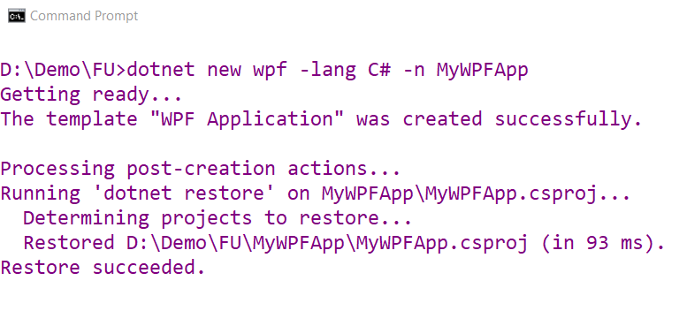
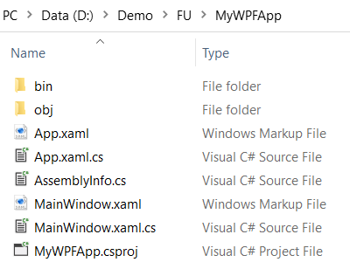
1. Install package: dotnet-sdk-5.0.102-win-x64.exe and open Command Prompt dialog
2. Create WPF App named MyWPFApp with C# language

Slide 22

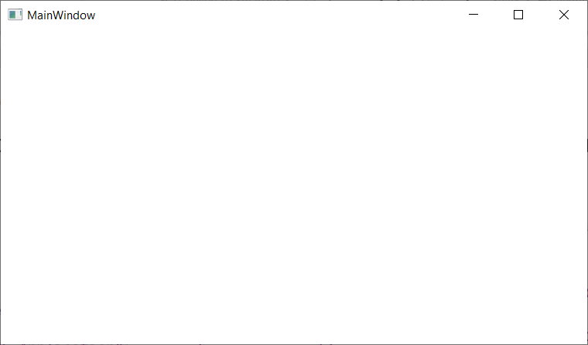
3. Run MyWPFApp application

Slide 23
Demo 02: Create a WPF Application using Visual Studio.NET

Slide 24
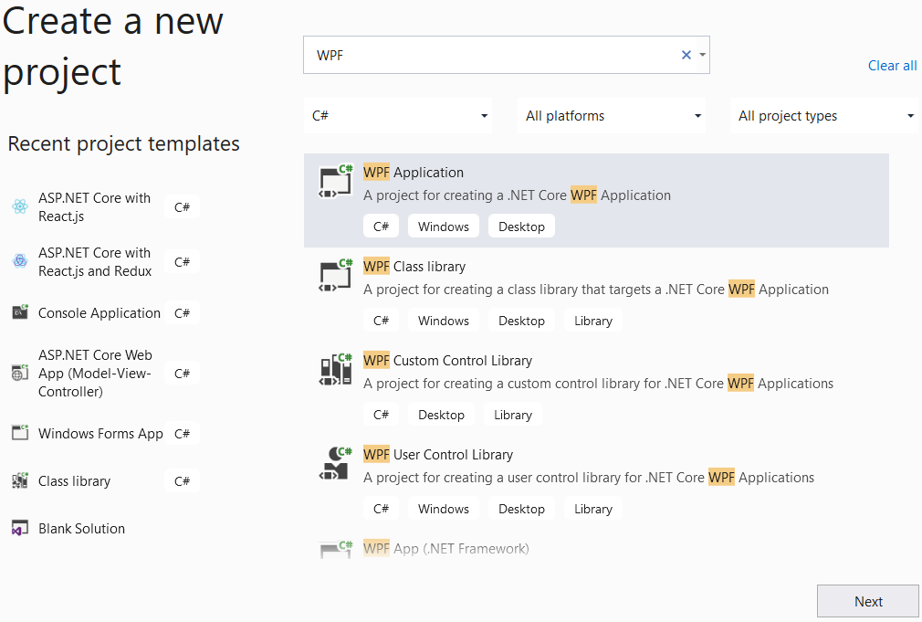
1. Open Visual Studio.NET , File | New | Project
1
2
3

Slide 25
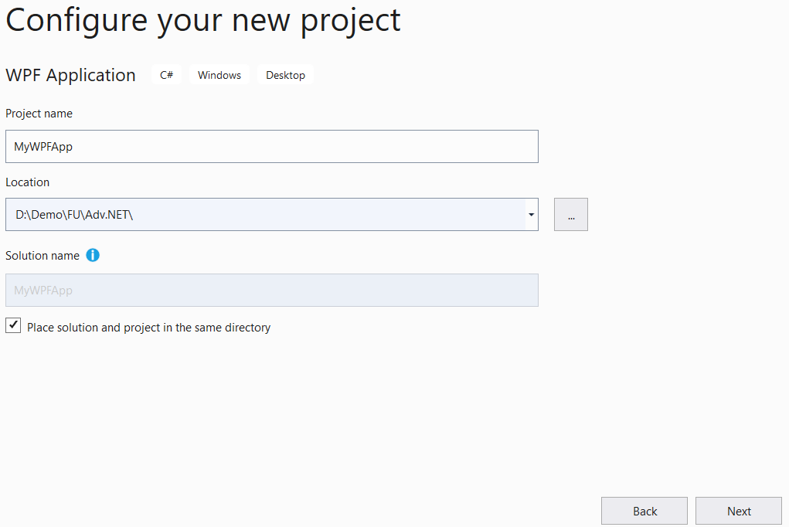
2. Fill out Project name: MyWPFApp and Location then click Next
4
5
6

Slide 26
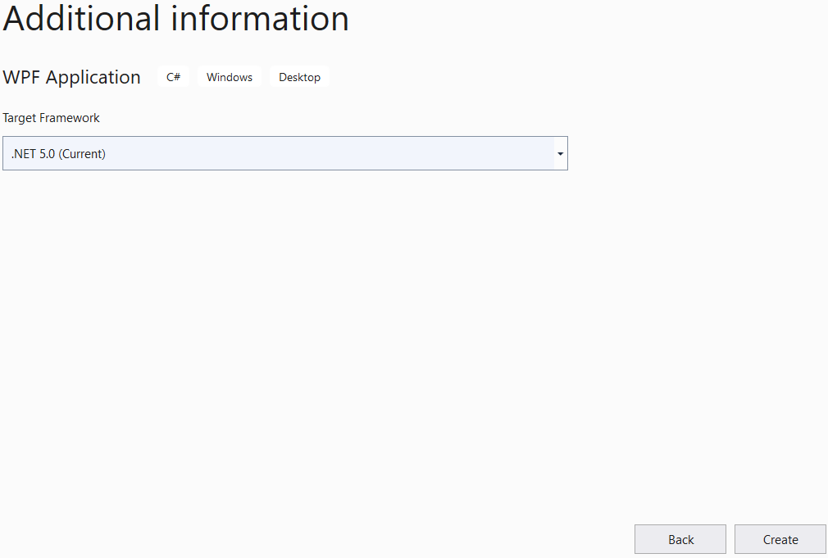
3. Choose Target Framework: .NET 5.0 (Current) then click Create
7
8

Slide 27
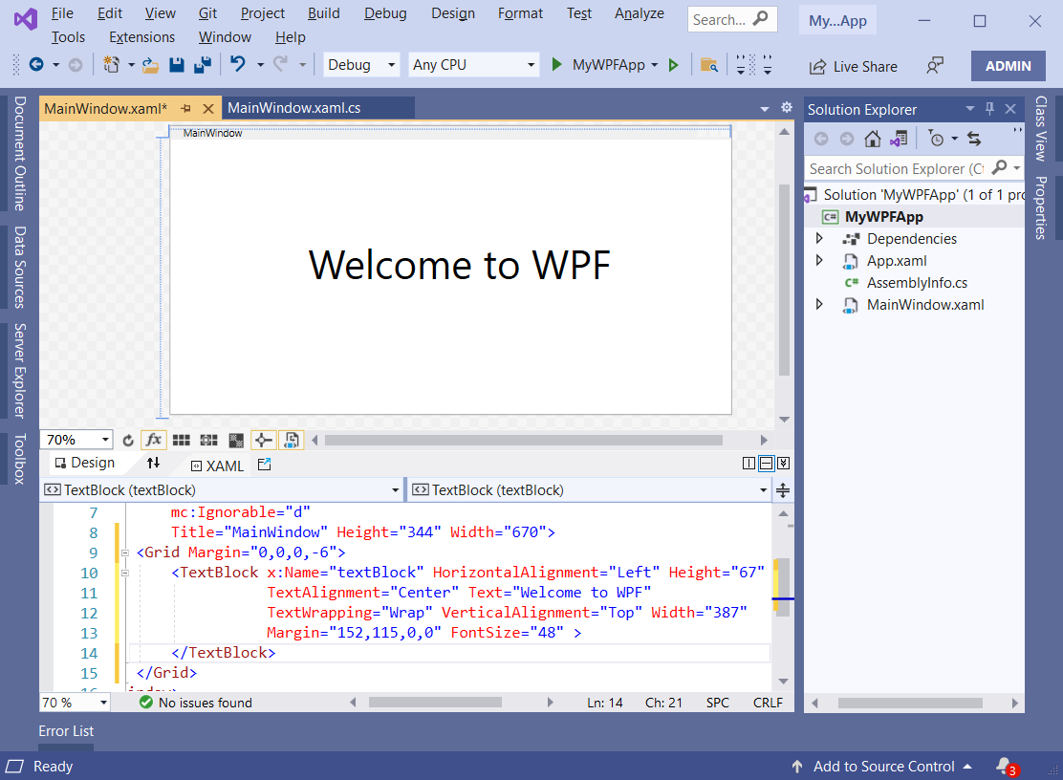
4. Update codes of the MainWindow.xaml

Slide 28
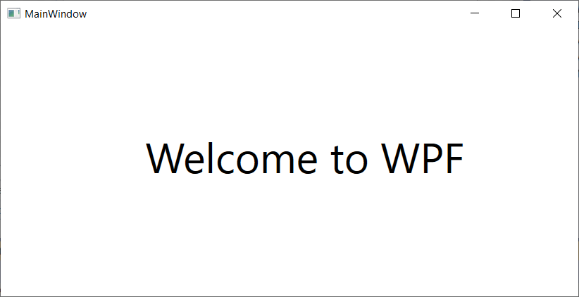
5. Press Ctrl+F5 to run application

Slide 29
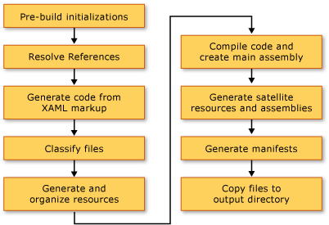
WPF Build Pipeline
When a WPF project is built, the combination of language-specific and WPF-specific targets are invoked. The process of executing these targets is called the build pipeline, and the key steps are illustrated by the following figure:

Slide 30
eXtensible Application Markup Language (XAML)

Slide 31
Understanding XAML
XAML is a declarative markup language. As applied to the .NET Core programming model, XAML simplifies creating a UI for a .NET Core app
We can create visible UI elements in the declarative XAML markup, and then separate the UI definition from the run-time logic by using code-behind files that are joined to the markup through partial class definitions
XAML directly represents the instantiation of objects in a specific set of backing types defined in assemblies
XAML enables a workflow where separate parties can work on the UI and the logic of an app, using potentially different tools
When represented as text, XAML files are XML files that generally have the .xaml extension. The files can be encoded by any XML encoding, but encoding as UTF-8 is typical

Slide 32
The Features of XAML
UI and Business Logic Separation: This is one of the greatest benefits of XAML. It separates design and development from each other. This provides more collaboration and efficiency between developers and designers of an application
High User Experience: XAML files are basically simple XML format files, so transferring user interfaces between platforms is easy. To design user interfaces using XAML is easier and also needs lesser code
Easier Extension: In XAML, .NET classes are placed in a hierarchical manner, where each element is the equivalent of a Core Common Language Runtime (Core CLR) class. So, extension of the .NET classes will be easier
Easier to implement Styles for UI: XAML makes the development of any user interface much faster and easier. It provides features such as creating layout, applying styles, and templates for the UI application

Slide 33
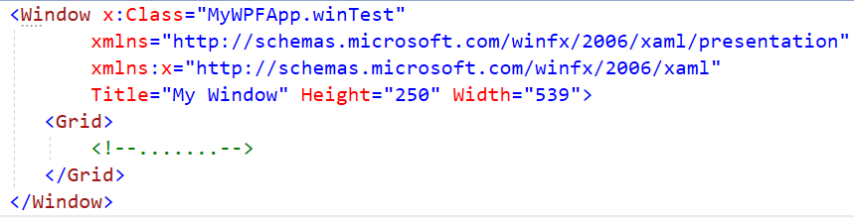
Basic Structure of XAML
A WPF application contains windows or pages. A Window is a top-level window with the tag, whereas the Page is a browser-hosted page with the <Page> tag in a XAML file
Apart from Window and Page, XAML has ResourceDictionary and Application root elements for specifying the external dictionary and application definition

Slide 34
Basic Structure of XAML
Window: One of commonly used root element which contains other elements
xmlns: Namespace declared specifically for WPF
xmlns:x: Namespace with keywords and markup extensions in XAML. It includes mapping with the x: prefix
Some commonly used prefixes are as follows:
x:Type : To specify the type
x:Null: To assign a null value
x:Class: Specifies the related code-behind file. Here, MyWPFApp is the name of an application and MyWin is the name of the class that binds the XAML file with the related codebehind file
Title: The title of the window
Grid: Displays tabular data in a row and column format
<Window x:Class="MyWPFApp.MyWin"
xmlns=“…"
xmlns:x=“…"
Title="My Window" >
<Grid>
<!--.......-->
</Grid>
</Window>

Slide 35
Attributes in XAML
The attribute element assigns the names for an event or value to the property
The attribute is mentioned using attribute name, an assignment operator, and the value of the attribute in quotation marks (“”)
The attributes are of two types
Property Attribute which defines properties for the element
Event Attribute which specifies handler for the element
Syntax
<...attribute_name="value"...>
<Button Background="Blue" Foreground="Red" Content="This is a button"/>

Slide 36
Elements in XAML
An XAML element instantiates a Core Common Language Runtime (Core CLR) class. The syntax of declaring elements is the same as element syntax of markup languages such as HTML, included two types:
Property element: enables to assign other element as a value of a property
Event element: handles an event of the control
Syntax – Property Element
<typeName.propertyName>...</typeName.propertyName >
<Button>
<Button.Foreground> <SolidColorBrush Color="Red"/> </Button.Foreground>
<Button.Content> This is a button </Button.Content>
</Button>
Syntax – Event Element
<typeName event="event handler">...</ typeName>
<Page xmlns=“…" xmlns:x=“…” x:Class="ExampleNamespace.ExamplePage">
<Button Click="Button_Click" >Click Me!</Button>
</Page>

Slide 37
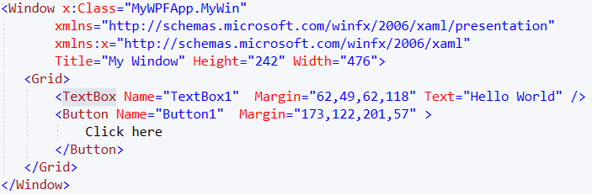
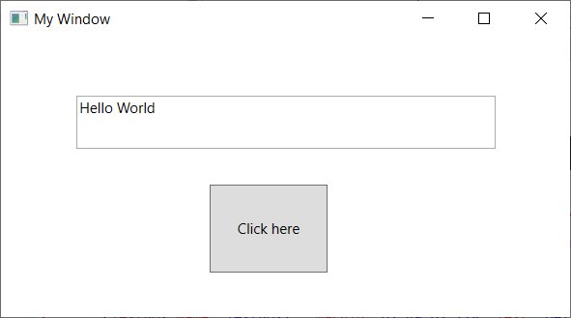
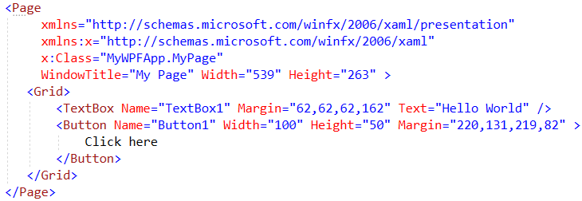
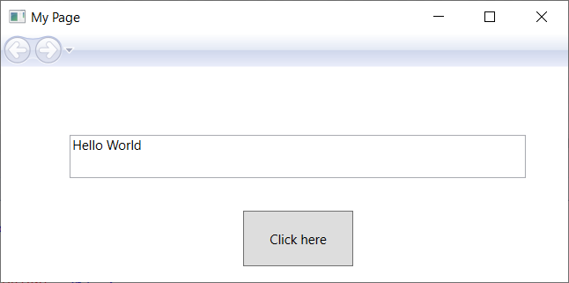
Defining the Window and Page

Slide 38
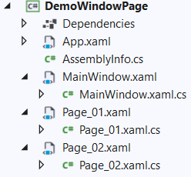
Demo Create Window and Page
1.Create a WPF project named DemoWindowPage
2.Right-click on project, select Add | Page (WPF)… and named Page_01.xaml
3.Right-click on project, select Add | Page (WPF)… and named Page_02.xaml

Slide 39
4.Open the Page_01.xaml and write codes as the follows:
<Page x:Class="DemoWindowPage.Page_01"
xmlns="http://schemas.microsoft.com/winfx/2006/xaml/presentation"
xmlns:x="http://schemas.microsoft.com/winfx/2006/xaml"
xmlns:mc="http://schemas.openxmlformats.org/markup-compatibility/2006"
xmlns:d="http://schemas.microsoft.com/expression/blend/2008"
xmlns:local="clr-namespace:Demo01_Window_Page"
mc:Ignorable="d" Width="500" Height="323"
Title="Page 01: Welcome to WPF" >
<Grid Background="LightGreen">
<TextBlock TextAlignment="Center" Width="362"
FontSize="24" FontWeight="Bold" Foreground="Red"
Text="Welcome to WPF"
Margin="69,130,69,151"/>
</Grid>
</Page>

Slide 40
5.Open the Page_02.xaml and write codes as the follows:
<Page x:Class="DemoWindowPage.Page_02"
xmlns="http://schemas.microsoft.com/winfx/2006/xaml/presentation"
xmlns:x="http://schemas.microsoft.com/winfx/2006/xaml"
xmlns:mc="http://schemas.openxmlformats.org/markup-compatibility/2006"
xmlns:d="http://schemas.microsoft.com/expression/blend/2008"
xmlns:local="clr-namespace:Demo01_Window_Page"
mc:Ignorable="d" Height="323" Width="500"
Title="Page 02: .NET Programming">
<Grid Background="PaleTurquoise">
<TextBlock TextAlignment="Center" Width="362"
FontSize="24" FontWeight="Bold"
Text=".NET Programming" Foreground="ForestGreen"
Margin="69,130,69,151"/>
</Grid>
</Page>

Slide 41
6.Open the MainWindow.xaml and write codes as the follows:
<Window x:Class="DemoWindowPage.MainWindow"
xmlns="http://schemas.microsoft.com/winfx/2006/xaml/presentation"
xmlns:x="http://schemas.microsoft.com/winfx/2006/xaml"
xmlns:d="http://schemas.microsoft.com/expression/blend/2008"
xmlns:mc="http://schemas.openxmlformats.org/markup-compatibility/2006"
xmlns:local="clr-namespace:Demo01_Window_Page"
mc:Ignorable="d" Title="Main Window" Height="456" Width="800">
<Grid>
<Frame x:Name="frMain" VerticalAlignment="Stretch" NavigationUIVisibility="Visible"/>
<Button Content="To page 1" Name="btnToPage01" Click="btnToPage01_Click"
HorizontalAlignment="Left" Margin="316,383,0,0"
Height="28" Width="79"/>
<Button Content="To page 2" Name="btnToPage02" Click="btnToPage02_Click"
HorizontalAlignment="Left" Margin="400,383,0,0"
Height="28" Width="79"/>
</Grid>
</Window>
Event Handler: Click

Slide 42
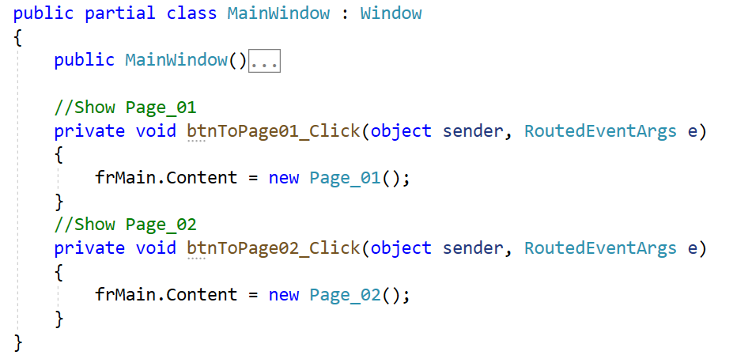
7.Open the MainWindow.xaml.cs and write codes as the follows:

Slide 43
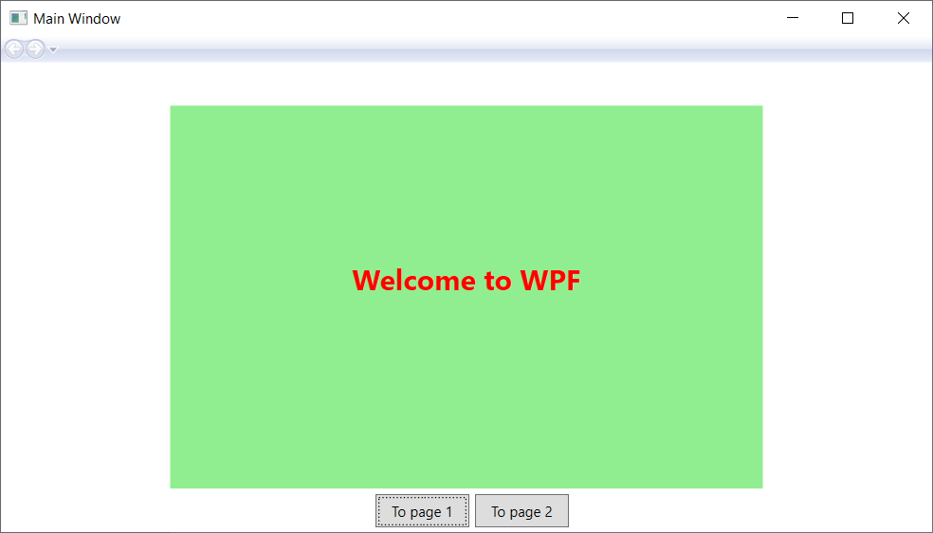
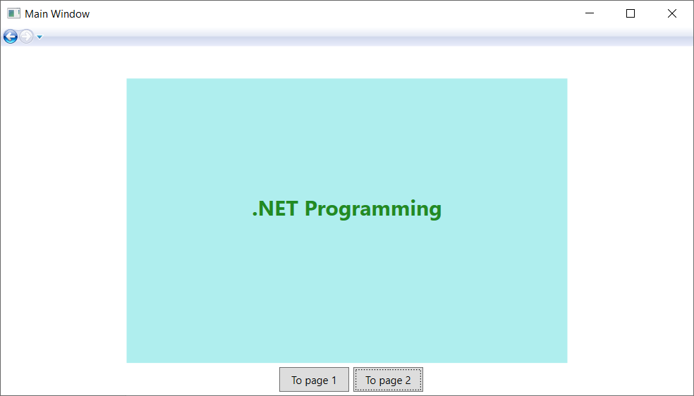
8.Press Ctrl+F5 to run project then click To page 1 or To page 2 button to view result

Slide 44
The Window Class
The System.Windows.Window class (located in the PresentationFramework.dll assembly) represents a single window owned by the Application-derived class, including any dialog boxes displayed by the main window
It serves as the root of a window and provides us with the standard border, title bar and maximize, minimize and close buttons
A WPF window is a combination of a XAML (.xaml) file, where the <Window> element is the root, and a CodeBehind (.cs) file

Slide 45
The Window Class
<Window xmlns="http://schemas.microsoft.com/winfx/2006/xaml/presentation"
Title="Main Window in Markup Only" Height="300"
Width="300"
/>
using System;
using System.Windows;
namespace CSharp {
public partial class CodeOnlyWindow : Window {
public CodeOnlyWindow() {
this.Title = "Main Window in Code Only";
this.Width = 300; this.Height = 300;
}
}
}

Slide 46
The Window Class
The following table describes some of the key properties:
Property | Description
DataContext | Gets or sets the data context for an element when it participates in data binding
DialogResult | Gets or sets the dialog result value, which is the value that is returned from the ShowDialog() method
SizeToContent | Decide if the Window should resize itself to automatically fit its content. The default is Manual, which means that the window doesn't automatically resize
Topmost | The default is false, but if set to true, our Window will stay on top of other windows unless minimized. Only useful for special situations
Opacity | Gets or sets the opacity factor applied to the entire UIElement when it is rendered in the user interface (UI). This is a dependency property
WindowStartupLocation | Gets or sets the position of the window when first shown
WindowState | Gets or sets a value that indicates whether a window is restored, minimized, or maximized
WindowStyle | Gets or sets a window's border style

Slide 47
The Window Class
The following table describes some of the key methods:
Method | Description
Activate() | Attempts to bring the window to the foreground and activates it
AddText(String) | Adds a specified text string to a ContentControl
Close() | Manually closes a Window
Hide() | Makes a window invisible
Show() | Opens a window and returns without waiting for the newly opened window to close
ShowDialog() | Opens a window and returns only when the newly opened window is closed
Show() | Opens a window and returns without waiting for the newly opened window to close
UpdateLayout() | Ensures that all visual child elements of this element are properly updated for layout
TransformToDescendant(Visual) | Returns a transform that can be used to transform coordinates from the Visual to the specified visual object descendant
BeginStoryboard(Storyboard) | Begins the sequence of actions that are contained in the provided storyboard

Slide 48
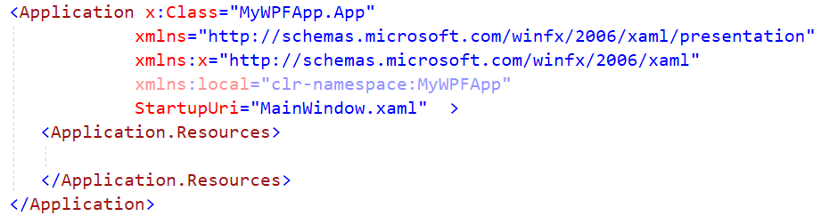
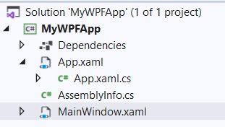
Defining the Application
Visual Studio generates a XAML application file that specifies:
The code-behind class for the application
The startup window or page
Application-wide resources

Slide 49
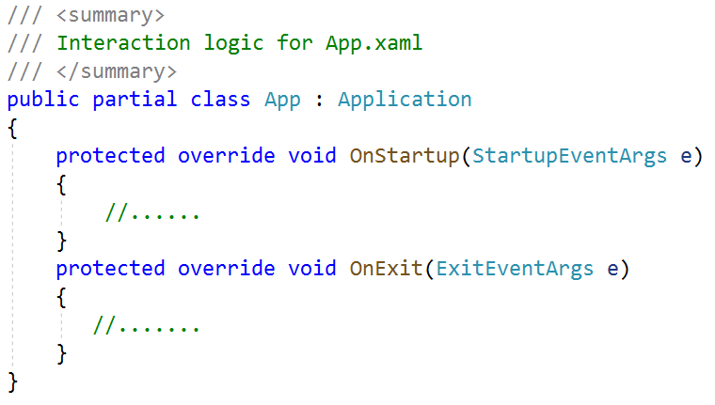
The Application Class
The System.Windows.Application class represents a global instance of a running WPF application
This class supplies a series of events that we are able to handle in order to interact with the application’s lifetime (such as OnStartup and OnExit)

Slide 50
The Application Class
The following table describes some of the key properties:
Property | Description
Current | This static property allows us to gain access to the running Application object from anywhere in our code. This can be helpful when a window or dialog box needs to gain access to the Application object that created it, typically to access application-wide variables and functionality
MainWindow | This property allows us to programmatically get or set the main window of the application
Properties | This property allows us to establish and obtain data that is accessible throughout all aspects of a WPF application (windows, dialog boxes, etc.)
StartupUri | This property gets or sets a URI that specifies a window or page to open automatically when the application starts
Windows | This property returns a WindowCollection type, which provides access to each window created from the thread that created the Application object. This can be helpful when we want to iterate over each open window of an application and alter its state (such as minimizing all windows)

Slide 51
Controls and Layouts in WPF

Slide 52
System.Windows.Controls.Control
Represents the base class for user interface (UI) elements that use a ControlTemplate to define their appearance
The Template property, which is a ControlTemplate, specifies the appearance of the Control. If we want to change the appearance of a control but retain its functionality, we should consider creating a new ControlTemplate instead of creating a new class
The Control class is the base class for many of the controls we add to an application such as TextBlock, Button, ListBox, etc

Slide 53
System.Windows.Controls.Control
The following table describes some of the key members of the Control type:
Members | Description
Background, Foreground, BorderBrush, BorderThickness, Padding, HorizontalContentAlignment, VerticalContentAlignment | These properties allow us to set basic settings regarding how the control will be rendered and positioned
FontFamily, FontSize, FontStretch, FontWeight | These properties control various font-centric settings
IsTabStop, TabIndex | These properties are used to establish tab order among controls on a window
MouseDoubleClick, PreviewMouseDoubleClick | These events handle the act of double-clicking a widget
Template | This property allows us to get and set the control’s template, which can be used to change the rendering output of the widget

Slide 54
Styles and Templates
WPF styling and templating refer to a suite of features that let developers and designers create visually compelling effects and a consistent appearance for their product
When customizing the appearance of an app, we want a strong styling and templating model that enables maintenance and sharing of appearance within and among apps. WPF provides that model
Another feature of the WPF styling model is the separation of presentation and logic. Designers can work on the appearance of an app by using only XAML at the same time that developers work on the programming logic by using C# or Visual Basic

Slide 55
Styles
A Style as a convenient way to apply a set of property values to multiple elements
We can use a style on any element that derives from FrameworkElement or FrameworkContentElement such as a Window or a Button
The most common way to declare a style is as a resource in the Resources section in a XAML file
If we declare the style in the root element of app definition XAML file, the style can be used anywhere in app

Slide 56
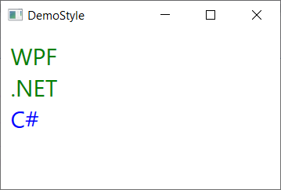
Styles
<Window x:Class="DemoWPFControls.DemoStyle"
<!--xmlns:-->
Title="DemoStyle" Height="200" Width="300">
<Window.Resources>
<Style TargetType="TextBlock">
<Setter Property="Foreground" Value="Green" />
<Setter Property="FontSize" Value="24" />
</Style>
</Window.Resources>
<StackPanel Margin="10">
<TextBlock>WPF</TextBlock>
<TextBlock>.NET</TextBlock>
<TextBlock Foreground="Blue">C#</TextBlock>
</StackPanel>
</Window>

Slide 57
Templates
A template describes the overall look and visual appearance of a control. For each control, there is a default template associated with it which gives the control its appearance
In WPF applications, we can easily create templates when we want to customize the visual behavior and visual appearance of a control
Connectivity between the logic and the template can be achieved by data binding. The main difference between styles and templates are listed below
Styles can only change the appearance of control with default properties of that control
With templates, we can access more parts of a control than in styles. we can also specify both existing and new behavior of a control

Slide 58
Templates
There are two types of templates which are most commonly used: Control Template and Data Template
Control Template defines the visual appearance of a control. All of the UI elements have some kind of appearance as well as behavior, e.g. Templates can be applied globally to application, windows and pages, or directly to controls. Most scenarios that require we to create a new control can be covered by instead creating a new template for an existing control
Data Template defines and specifies the appearance and structure of a collection of data. It provides the flexibility to format and define the presentation of the data on any UI element. It is mostly used on data related Item controls such as ComboBox, ListBox, etc

Slide 59
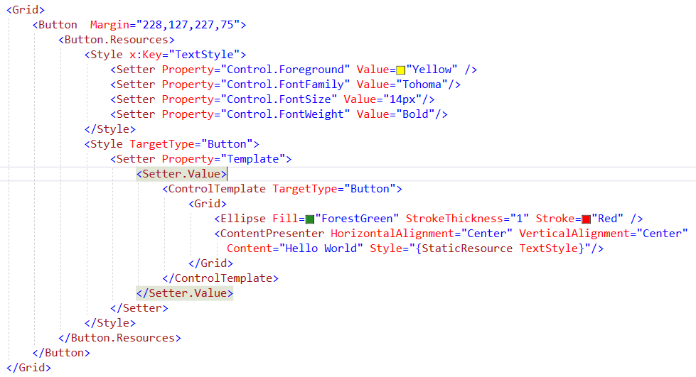
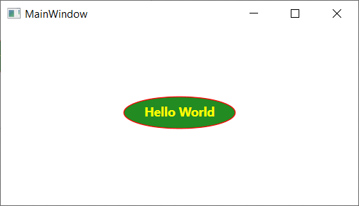
Control Template with Button Demo

Slide 60
Controlling Content Layout Using Panels
A WPF application invariably contains a good number of UI elements (e.g., user input controls, graphical content, menu systems, and status bars) that need to be well organized within various windows.
After place the UI elements, we need to make sure they behave as intended when the end user resizes the window or possibly a portion of the window (as in the case of a splitter window)
To ensure our WPF controls retain their position within the hosting window, we can take advantage of a good number of panel types (also known as layout managers)
By default, a new WPF Window created with Visual Studio will use a layout manager of type Grid

Slide 61
Controlling Content Layout Using Panels
The System.Windows.Controls namespace provides numerous panels, each of which controls how sub elements are maintained. The following table documents the role of some commonly used WPF panel controls:
Panel Control | Description
Canvas | Provides a classic mode of content placement. Items stay exactly where we put them at design time
DockPanel | Locks content to a specified side of the panel (Top, Bottom, Left, or Right)
Grid | Arranges content within a series of cells, maintained within a tabular grid
StackPanel | Stacks content in a vertical or horizontal manner, as dictated by the Orientation property
WrapPanel | Positions content from left to right, breaking the content to the next line at the edge of the containing box. Subsequent ordering happens sequentially from top to bottom or from right to left, depending on the value of the Orientation property

Slide 62
Canvas Panel Demo
1. Create a DemoCanvasPanel.xaml and write codes as follows:
<Window x:Class="MyWPFApp.DemoCanvasPanel"
<!–- xmlns=… -->
Title="Canvas Panel" Height="300" Width="400" WindowStartupLocation="CenterScreen" >
<Grid>
<Canvas Background="LightBlue">
<Button x:Name="btnDisplay" Canvas.Left="94" Height="28" Canvas.Top="203"
Width="80" Content="Display" Click="btnDisplay_Click" />
<Label x:Name="lblInstructions" Canvas.Left="17" Canvas.Top="14"
Width="328" Height="27" FontSize="15" Content="Enter Car Information"/>
<Label x:Name="lblCarName" Canvas.Left="17" Canvas.Top="60" Content="Car Name"/>
<TextBox x:Name="txtCarName" Canvas.Left="94" Canvas.Top="60" Width="193" Height="25"/>
<Label x:Name="lblColor" Canvas.Left="17" Canvas.Top="109" Content="Color"/>
<TextBox x:Name="txtColor" Canvas.Left="94" Canvas.Top="107" Width="193" Height="25"/>
<Label x:Name="lblBrand" Canvas.Left="17" Canvas.Top="155" Content="Brand"/>
<TextBox x:Name="txtBrand" Canvas.Left="94" Canvas.Top="153" Width="193" Height="25"/>
</Canvas>
</Grid>
</Window>

Slide 63
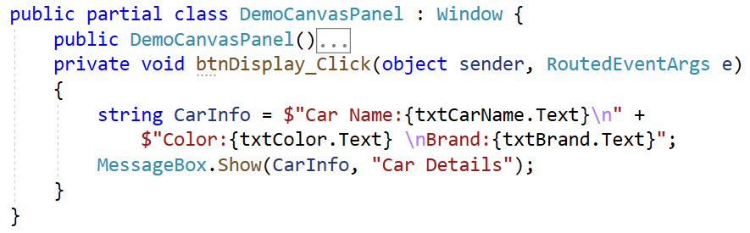
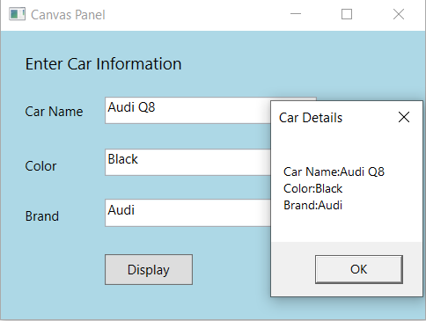
Canvas Panel Demo
2. Open DemoCanvasPanel.xaml.cs then write codes and run

Slide 64
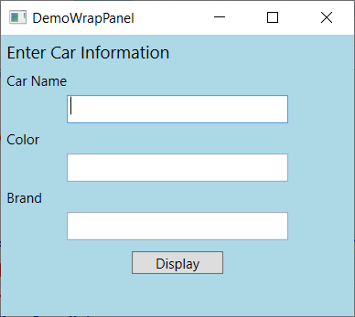
WrapPanel Demo
Positions child elements in sequential position from left to right, breaking content to the next line at the edge of the containing box. Subsequent ordering happens sequentially from top to bottom or from right to left, depending on the value of the Orientation property
Grid>
<WrapPanel Background="LightBlue" Orientation ="Vertical">
<Label Name="lblInstruction" Width="328" Height="27"
FontSize="15" Content="Enter Car Information"/>
<Label Name="lblCarName" Content="Car Name"/>
<TextBox Name="txtCarName" Width="193" Height="25"/>
<Label Name="lblColor" Content="Color"/>
<TextBox Name="txtColor" Width="193" Height="25"/>
<Label Name="lblBrand" Content="Brand"/>
<TextBox Name="txtBrand" Width="193" Height="25"/>
<Button Name="btnDisplay" Width="80"
Margin="0,10,0,0" Content="Display"/>
</WrapPanel>
</Grid><

Slide 65
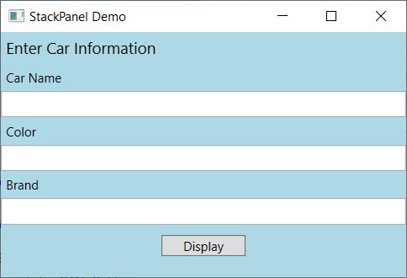
StackPanel Demo
Arranges child elements into a single line that can be oriented horizontally or vertically
<Grid>
<StackPanel Background="LightBlue“ Orientation ="Vertical">
<Label Name="lblInstruction"
FontSize="15" Content="Enter Car Information"/>
<Label Name="lblCarName" Content="Car Name"/>
<TextBox Name="txtCarName" Height="25"/>
<Label Name="lblColor" Content="Color"/>
<TextBox Name="txtColor" Height="25"/>
<Label Name="lblBrand" Content="Brand"/>
<TextBox Name="txtBrand" Height="25"/>
<Button Name="btnDisplay" Width="80"
Margin="0,10,0,0" Content="Display"/>
</StackPanel>
</Grid>

Slide 66
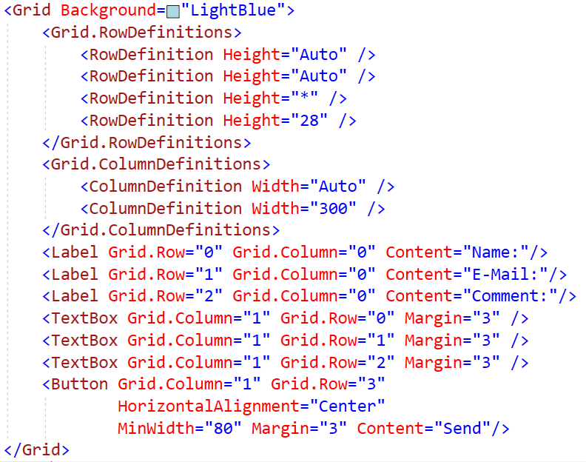
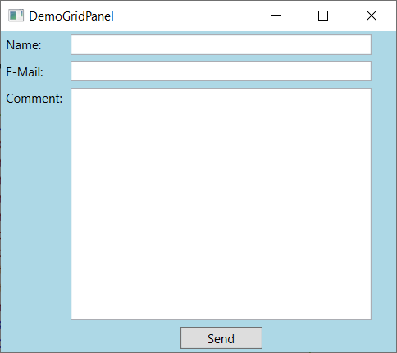
Grid Panel Demo
Defines a flexible grid area that consists of columns and rows

Slide 67
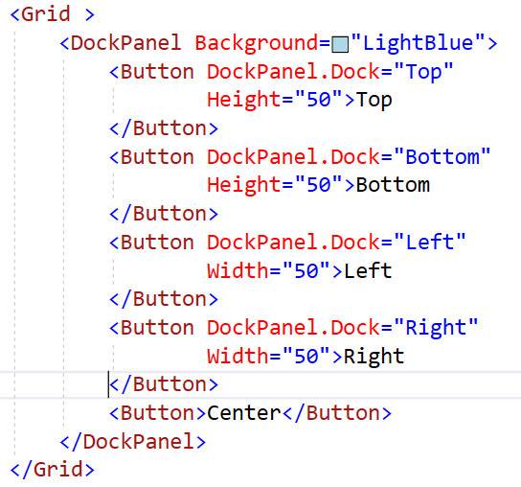
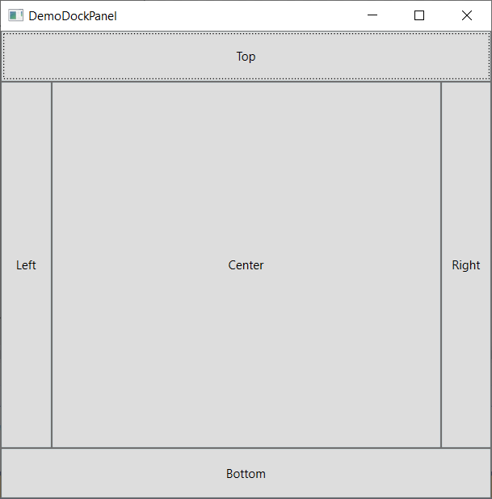
DockPanel Demo
Defines an area where we can arrange child elements either horizontally or vertically, relative to each other

Slide 68
Controls in WPF
WPF has a rich set of UI controls. These controls are grouped into various categories depending on their functionality, as shown in the following table:
Category | Controls
Layout | Border, Canvas, DockPanel, Grid, GridView, GridSplitter, GroupBox, Panel, StackPanel, Viewbox, WrapPanel
Core user input controls | Button, Calendar, DatePicker, Expander, DataGrid, ToggleButton, ScrollBar, Slider,TextBlock, TextBox, RepeatButton, RichTextBox, Label, PasswordBox
Menus | ContextMenu, Menu, ToolBar
Selection | CheckBox, ComboBox, ListBox, ListView, TreeView, RadioButton
Navigation | Frame, Hyperlink, Page, NavigationWindow, TabControl
User Information | AccessText, Label, Popup, ProgressBar, StatusBar, TextBlock, ToolTip
Media | Image, MediaElement, SoundPlayerAction

Slide 69
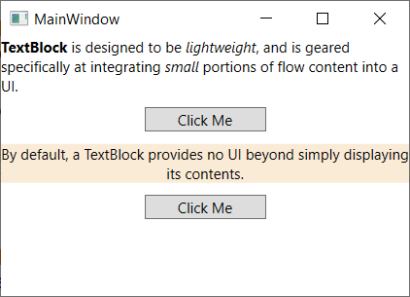
TextBlock
Provides a lightweight control for displaying small amounts of flow content
<Grid>
<StackPanel>
<TextBlock Name="textBlock1" TextWrapping="Wrap">
<Bold>TextBlock</Bold> is designed to be
<Italic>lightweight</Italic>,
and is geared specifically at integrating
<Italic>small</Italic>
portions of flow content into a UI.
</TextBlock>
<Button Width="100" Margin="10">Click Me</Button>
<TextBlock Name="textBlock2" TextWrapping="Wrap"
Background="AntiqueWhite" TextAlignment="Center">
By default, a TextBlock provides no UI
beyond simply displaying its contents.
</TextBlock>
<Button Width="100" Margin="10">Click Me</Button>
</StackPanel>
</Grid>

Slide 70
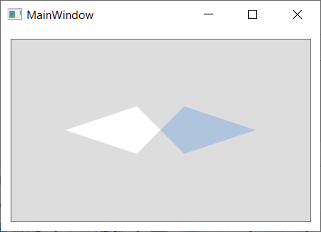
Button
Represents a Windows button control, which reacts to the Click event
<Window x:Class="DemoWPFControls.MainWindow"
//xmlns:…
Title="MainWindow" Height="250" Width="350">
<Grid>
<Button Margin="10">
<Grid>
<Polygon Points="100,25 125,0 200,25 125,50"
Fill="LightSteelBlue" />
<Polygon Points="100,25 75,0 0,25 75,50"
Fill="White"/>
</Grid>
</Button>
</Grid>
</Window>

Slide 71
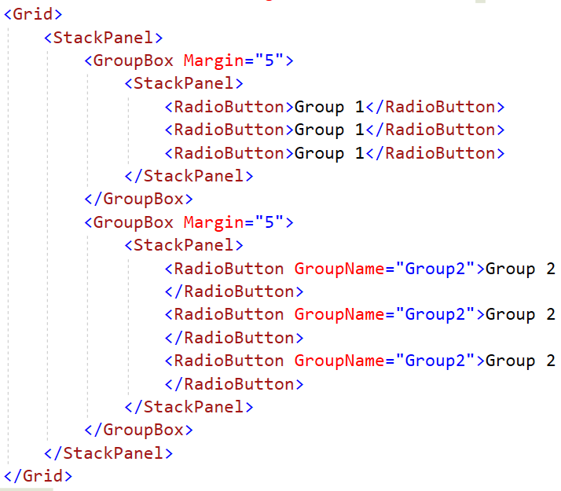
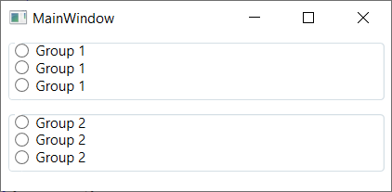
RadioButton
Represents a button that can be selected, but not cleared, by a user

Slide 72
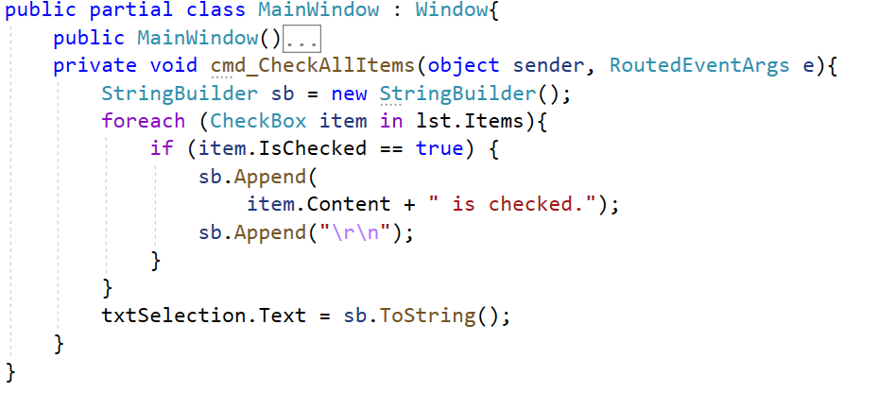
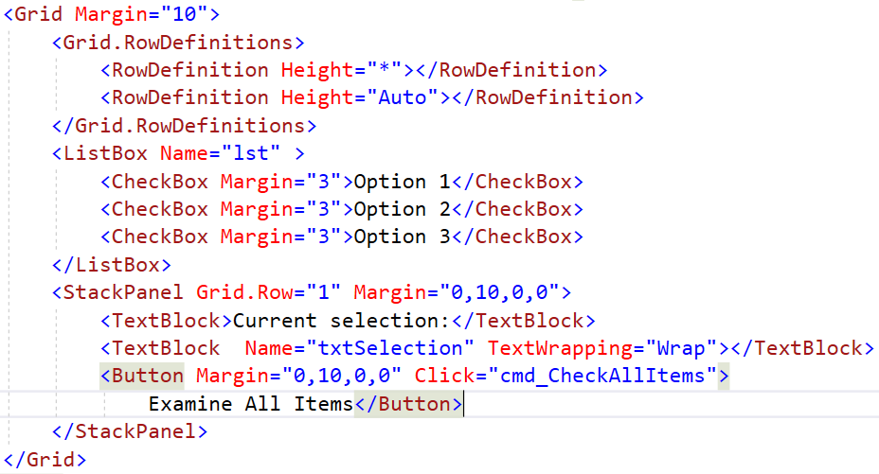
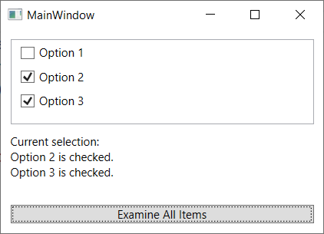
ListBox
Contains a list of selectable items

Slide 73
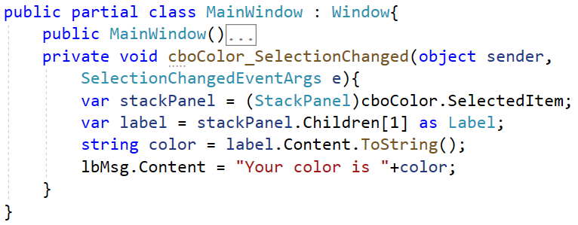
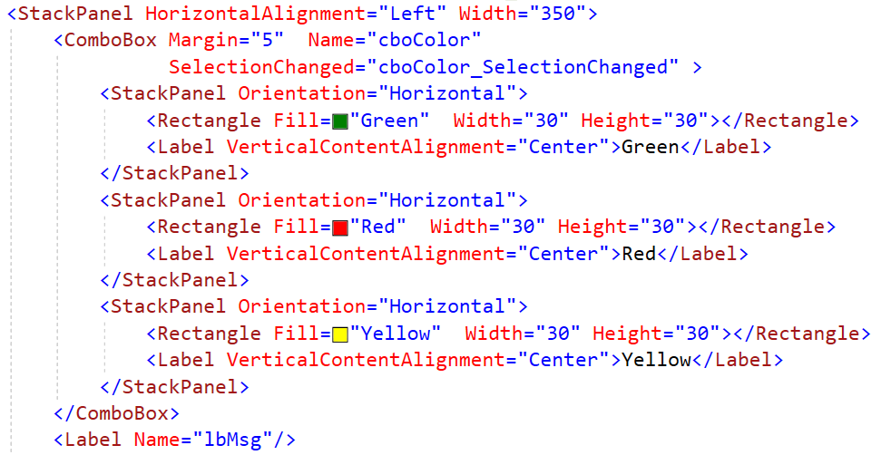
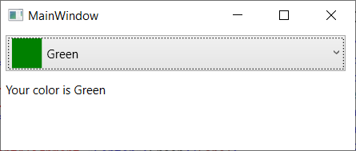
ComboBox
Represents a selection control with a drop-down list that can be shown or hidden by clicking the arrow on the control

Slide 74
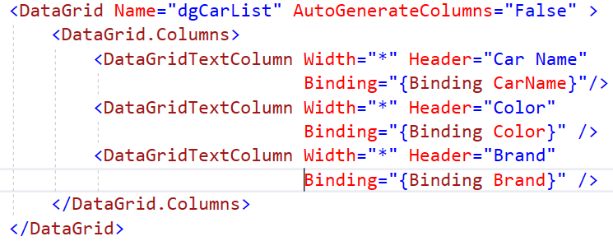
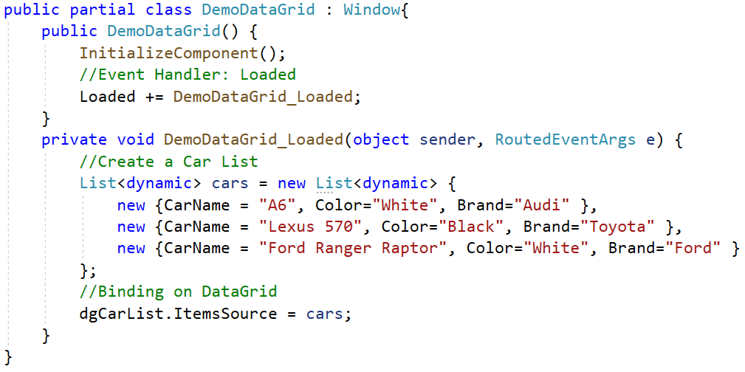
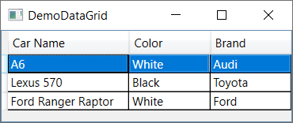
DataGrid
Represents a control that displays data in a customizable grid

Slide 75
Understanding Data Binding
Data binding is the process that establishes a connection between the app UI and the data it displays. If the binding has the correct settings and the data provides the proper notifications, when the data changes its value, the elements that are bound to the data reflect changes automatically
Data binding can also mean that if an outer representation of the data in an element changes, then the underlying data can be automatically updated to reflect the change.
For example: if the user edits the value in a TextBox element, the underlying data value is automatically updated to reflect that change
A typical use of data binding is to place server or local configuration data into forms or other UI controls. In WPF, this concept is expanded to include binding a broad range of properties to a variety of data sources

Slide 76
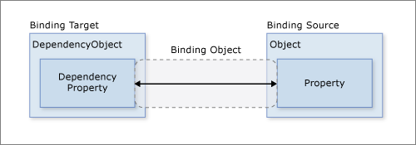
Understanding Data Binding
Typically, each binding has four components:
A binding target object
A target property
A binding source
A path to the value in the binding source to use

Slide 77
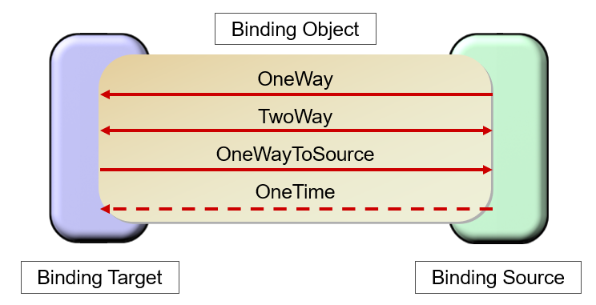
Understanding Data Binding
WPF supports four data-binding modes:

Slide 78
Understanding Data Binding
OneWay binding causes changes to the source property to automatically update the target property, but changes to the target property are not propagated back to the source property. This type of binding is appropriate if the control being bound is implicitly read-only
TwoWay binding causes changes to either the source property or the target property to automatically update the other. This type of binding is appropriate for editable forms or other fully interactive UI scenarios. Most properties default to OneWay binding, but some dependency properties (typically properties of user-editable controls such as the TextBox.Text and CheckBox.IsChecked) default to TwoWay binding

Slide 79
Understanding Data Binding
OneWayToSource is the reverse of OneWay binding; it updates the source property when the target property changes. One example scenario is if we only need to reevaluate the source value from the UI
OneTime is essentially a simpler form of OneWay binding that provides better performance in cases where the source value does not change. Updates the binding target when the application starts or when the data context changes. This type of binding is appropriate if we are using data where either a snapshot of the current state is appropriate to use or the data is truly static

Slide 80
Access to Database Demonstration

Slide 81


Create a sample database named MyStore includes a table named Categories as follows:

Slide 82

1.Create a WPF app named ManageCategoriesApp includes a window named WindowManageCategories.xaml that has controls as follows :
Label Control
TextBox Control
Button Control
ListView Control

Slide 83

XAML code of WindowManageCategories.xaml:
View details in next slide

Slide 84
XAML code of Grid tag
<Grid>
<Grid.RowDefinitions>
<RowDefinition Height="*"/>
<RowDefinition Height="*"/>
</Grid.RowDefinitions>
<StackPanel Background="LightBlue" Orientation ="Vertical"
HorizontalAlignment="Left" Width="400">
<Label Name="lblInstruction" Foreground="Red" FontWeight="DemiBold"
FontSize="20" Content="Category Information"/>
<Label Name="lblCategoryID" Content="CategoryID"/>
<TextBox Name="txtCategoryID" HorizontalAlignment="Left"
IsReadOnly="True" Height="25" Width="300"
Text="{Binding Path=CategoryID, Mode=OneWay} "
DataContext="{Binding ElementName=lvCategories, Path=SelectedItem} " />
<Label Name="lbCategoryName" Content="Category Name" />
<TextBox Name="txtCategoryName" HorizontalAlignment="Left"
Height="25" Width="300" Text="{Binding Path=CategoryName, Mode=OneWay} "
DataContext="{Binding ElementName=lvCategories, Path=SelectedItem} " />
Data binding: OneWay mode

Slide 85
XAML code of Grid tag (cont.)
<StackPanel Orientation="Horizontal" HorizontalAlignment="Left">
<Button x:Name="btnInsert" Margin="10" Width="80" Content="Insert"
Click="btnInsert_Click" />
<Button x:Name="btnUpdate" Margin="10" Width="80" Content="Update"
Click="btnUpdate_Click" />
<Button x:Name="btnDelete" Margin="10" Width="80" Content="Delete"
Click="btnDelete_Click" />
</StackPanel>
</StackPanel>
<ListView Grid.Row="1" Name="lvCategories" Width="400" >
<ListView.View>
<GridView>
<GridViewColumn Header="Category ID" Width="100"
DisplayMemberBinding="{Binding Path=CategoryID } "/>
<GridViewColumn Header="Category Name" Width="200"
DisplayMemberBinding="{Binding Path=CategoryName} "/>
</GridView>
</ListView.View>
</ListView>
</Grid>
Event Handler: Click
Data binding

Slide 86

2.Right-click on the project | Add | Class, named ManageCategories.cs then write codes as follows ( Note: Install Microsoft.Data.SqlClient package from Nuget)

Slide 87



Slide 88


Slide 89

3.Write codes in WindowManageCategories.xaml.cs as follows:

Slide 90


Slide 91


Slide 92

4. Press Ctrl+F5 to run project and view the output

Slide 93
Introduction to MVVM Pattern (Model-View-ViewModel)

Slide 94
MVVM Pattern (Model-View-ViewModel)
MVVM was introduced by John Gossman in 2005 specifically for use with WPF as a concrete application of Martin Fowler's broader Presentation Model pattern
The implementation of an application, based on the MVVM patterns, uses various platform capabilities that are available in some form for WPF, Silverlight Desktop/web, and on Windows. Many commercial applications, including Microsoft Expression products, were built following MVVM
The Model, View, ViewModel (MVVM pattern) is all about guiding us in how to organize and structure our code to write maintainable, testable and extensible applications

Slide 95


MVVM Pattern (Model-View-ViewModel)

Slide 96
MVVM Pattern (Model-View-ViewModel)
Model: The model is the object representation of data. In MVVM, models are conceptually the same as the models from data access layer (DAL)
ViewModel is a non-visual class. The MVVM Design Pattern does not derive from any WPF based class. The ViewModel is unaware of the view directly. Communication between the View and ViewModel is through some property and binding. Models are connected directly to the ViewModel and invoke a method by the model class, it knows what the model has, like properties, methods etcetera and also is aware of what the view needs
View: The View is the graphical interface incharge of displaying data to users and interacting with them. In a WPF application, the View might be a UserControl, a Window, or a Page

Slide 97
MVVM Advantages
Maintainability
A clean separation of different kinds of code should make it easier to go into one or several of those more granular and focused parts and make changes without worrying. That means we can remain agile and keep moving out to new releases quickly
Testability
With MVVM each piece of code is more granular and if it is implemented right our external and internal dependences are in separate pieces of code from the parts with the core logic that we would like to test. That makes it a lot easier to write unit tests against a core logic
Extensibility
It sometimes overlaps with maintainability, because of the clean separation boundaries and more granular pieces of code. We have a better chance of making any of those parts more reusable

Slide 98
Summary
Concepts were introduced:
Overview Windows Presentation Foundation (WPF)
Overview XAML(eXtensible Application Markup Language) in WPF
Explain about Controls and Layouts in WPF
Explain about Styles and Templates in WPF
Explain about WPF Data-Binding Model
Demo create WPF application by dotnet CLI and Visual Studio.NET
Demo access to the database by WPF Application
Explain about MVVM Pattern (Model-View-ViewModel)

Slide 99
Lab and Assigment
1. Do Hands-on Lab: Lab_01_AutomobileManagement_Using_EntityFramework and WPF 2. Do Assigment: Assignment_01_SalesManagement.pdf

